Slide 1

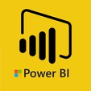
Hii, Iam Siddhika
Welcome to Power BI Series
Part -17

Slide 2

Today Content
I’m soo Excited.
Are you ready guys?
Meet DAX
INTRODUCTION TO DAX TWO WAYS TO USE DAX M VS. DAX

Slide 3

INTRODUCTION TO DAX
Data Analysis Expressions (commonly known as DAX) is the formula language that drives the Power BI front-end.
Have you got it?
In Simple to understand:
DAX is like the supercharged tool for Power BI. It's a special language that helps Power BI do its magic. With DAX, you can do more than just regular spreadsheet stuff. It has really strong and flexible functions made just for working with data that's connected in a certain way.

Slide 4

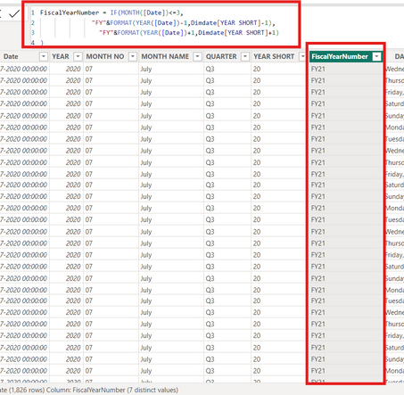
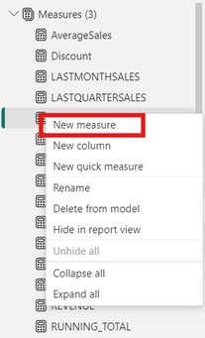
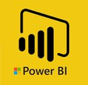
TWO WAYS TO USE DAX
Add calculated columns (for filtering) and measures
(for aggregation) to enhance data models
Will see
more about
this in next
posts
TWO WAYS TO USE DAX
calculated columns
measures

Slide 5

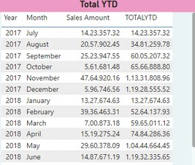
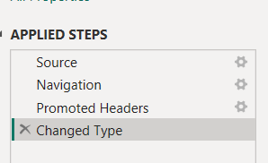

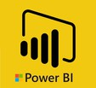
M VS. DAX
M and DAX are two distinct functional languages used within Power BI Desktop:
M is used in the Power Query editor, and is designed specifically for extracting, transforming and loading data
DAX is used in the Power BI front-end, and is designed specifically for analyzing relational data models
Do you get the difference?
DAX
Report View
M
Query Editor

Slide 6


Thank you for joining me today to learn about Part -17 of Power BI!
Remember, mastering DAX is key to unlocking the full potential of Power BI for insightful reporting and visualization.
Stay tuned for more insights and tips on Power BI in our next Series.
Follow
Siddhika Shah

